Slide 1

PYTHON
DATA TYPES

Slide 2

OBJECTIVES
About data types.
Types of data type.
Two examples of data types.
Numeric
Boolean

Slide 3
DATA TYPES
Data type is basically the type or kind of the values that makes up the data.
Classification or Categorization of data items.

Slide 4
EXAMPLE
Consider a database of students belonging to same class 5, the database consist of Name, Class, Age, Final Scores of student as well as whether they passed the exams or not.
Name | Class | Age | Grades | Passed
Adam | 5 | 11 | 7.0 | True
John | 5 | 11 | 5.0 | True
Harry | 5 | 12 | 3.0 | False
Gilbert | 5 | 10 | 9.0 | True
Edward | 5 | 11 | 4.0 | False

Slide 5
PYTHON DATA TYPES
There are basically two types of data types in python namely:
Built in data types.
User defined data types.

Slide 6
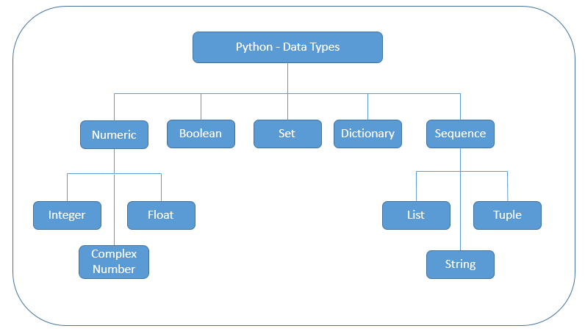
PYTHON DATA TYPES

Slide 7
NUMERIC DATA TYPE
Represents data which has numeric value
Numeric value can be integer, floating point as well as complex numbers.
The data types are
1. Integer ( represented by int class ).
2. Floating ( represented by float class ).
3. Complex ( represented by complex class ).

Slide 8
BOOLEAN
Boolean is a data type which has only two built- in values either True or False.
It is represented by class “bool”

Slide 9

There are two types of data types namely:
1. Built in data types.
2. User defined data types.
Numeric data types has numerical values such as integer, float and complex numbers as data types.
Boolean data types are only True or False
Sequence data type are of three types namely string, list and tuples.
User defined data types are derived from built in data types.
SUMMARY

